Slide 1
Object-Oriented Programming Using Java
Exception Handling

Slide 2
Contents
What Is an Exception
Handling Exception by the try…catch…finally block
How to throw exceptions
Checked and Unchecked exceptions
References: https://docs.oracle.com/javase/tutorial/essential/exceptions/index.html

Slide 3
What Is an Exception?
An exception is an event, which occurs during the execution of a program, that disrupts the normal flow of the program's instructions.
Notes:
Gián đoạn

Slide 4
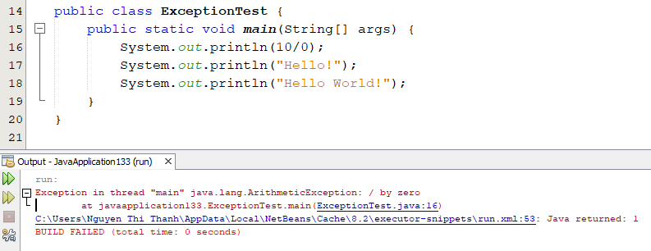
Example 1

Slide 5
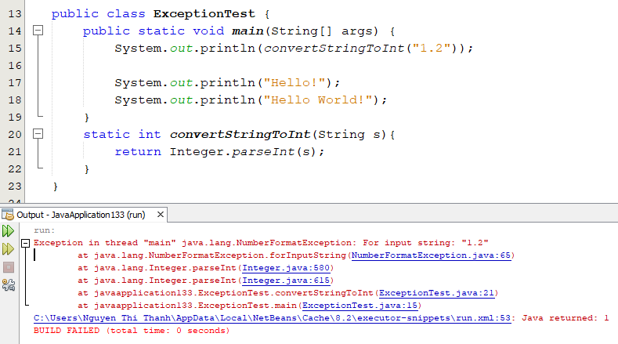
Example 2

Slide 6
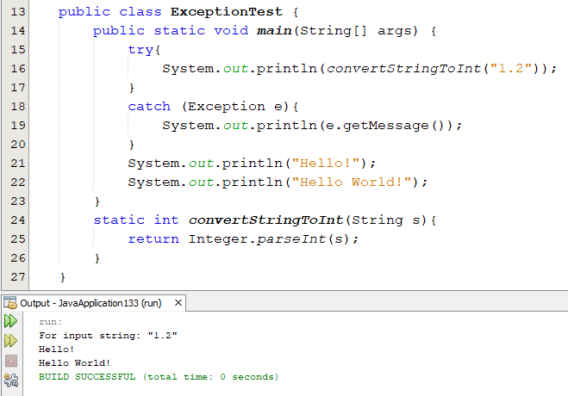
Handling Exception

Slide 7
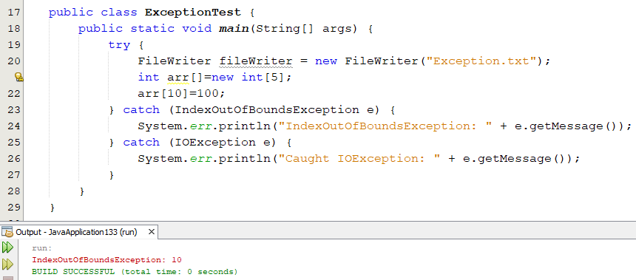
try…catch… block
a try block with one or more catch blocks

Slide 8
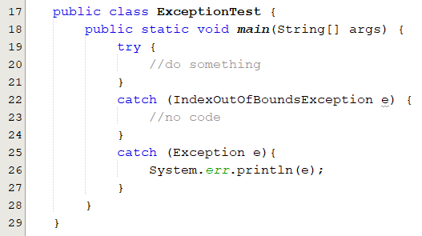
try…catch… block
Can be no code here

Slide 9
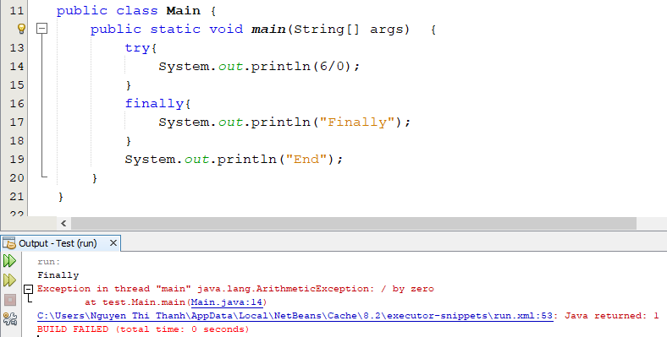
finally block
The Finally block always executes when the try block exists

Slide 10
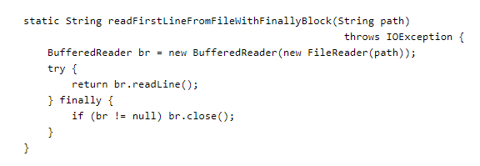
finally block
ensure that a resource is closed
Notes:
you can use a finally block to ensure that a resource is closed regardless of whether the try statement completes normally or abruptly. The following example uses a finally block instead of a try-with-resources statement:

Slide 11
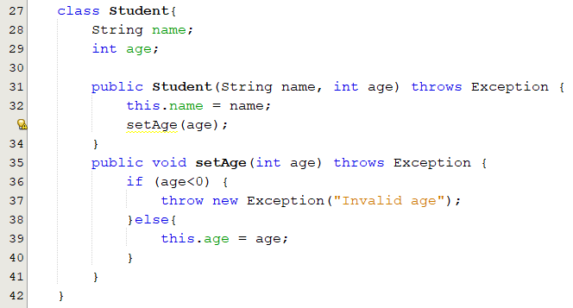
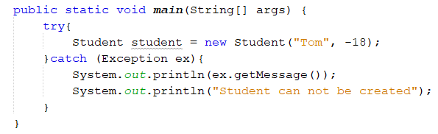
Throw Exceptions

Slide 12
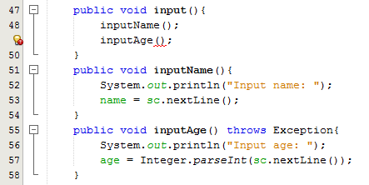
throws-declaration
error: unreported exception Exception; must be caught or declared to be thrown

Slide 13
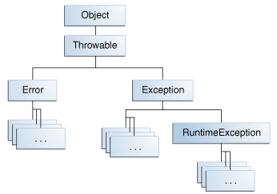
Two Kinds of Exception
Checked exception
Unchecked exception

Slide 14
Checked exception
  Must be handled by either
    the try-catch mechanism
    or the throws-declaration mechanism.

Slide 15
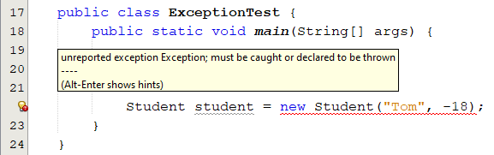
Checked exception Demo

Slide 16
Lưu ý
public class ExceptionTest {
//loại Exception bắt buộc phải khai báo đầu hàm
void X() throws Exception{
throw new Exception("Exception Message");
}
void Y(){
throw new RuntimeException("RuntimeException Message");
}
}

Slide 17
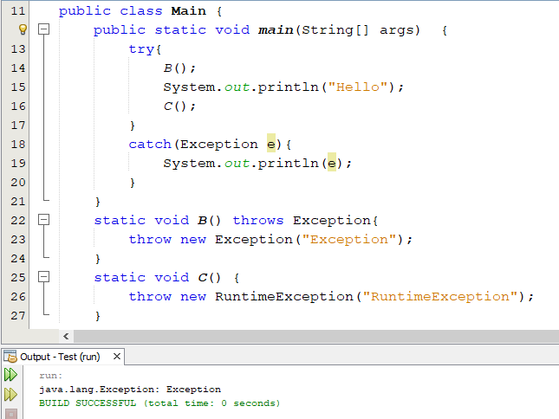
Output?

Slide 18
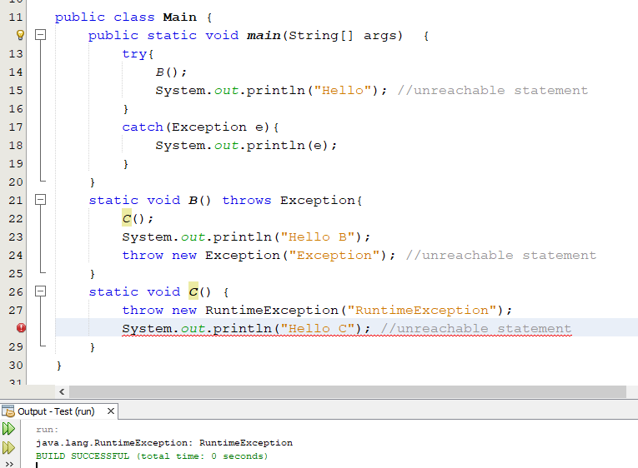
Output?

Slide 19
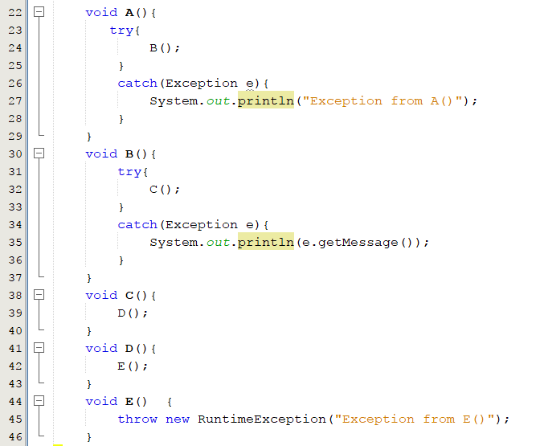


Output?

Slide 20
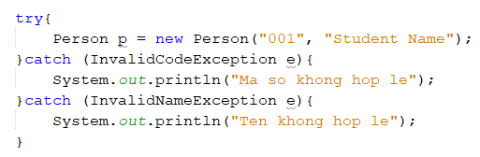
Creating Your Own Exception Classes
public class InvalidNameException extends Exception {
public InvalidNameException(String message) {
super(message);
}
}

Slide 21

Q&A

